Slide 1
Lecture #12: Responsible Data Science and Wrap-Up

Slide 2
ANNOUNCEMENTS
The Final Exam (individual work) is available and due Monday, Aug. 3.
There is a 1% penalty if handed in up to 24 hours late (max = 99/100)
A few clarifications:
Unless specifically mentioned as departure delay, and reference to a delay should be assumed to be an arrival delay.
Determining whether a flight is delayed or not it always whether the actual time of departure/arrival is 15 minutes or more after it’s scheduled time.
Friday’s lab will include general review: both conceptual and technical (partially based on today’s quiz)

Slide 3
Outline
Ethical Data Science
Case Study: Bias in the COMPAS algorithm
Wrap-Up

Slide 4
Ethical Data Science *slides modified by CS 109’s guest speaker in Fall 2018: Julia Stoyanovich, NYU https://engineering.nyu.edu/faculty/julia-stoyanovich

Slide 5

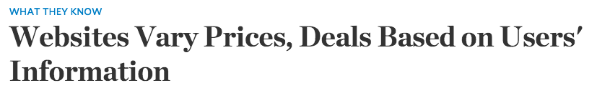
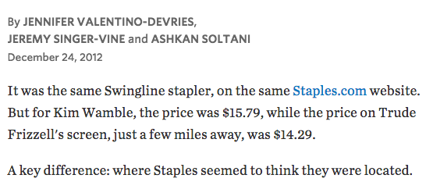
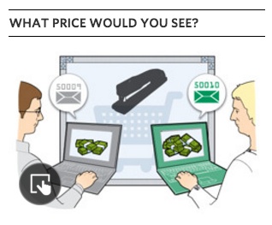
Online price discrimination
lower prices offered to buyers who live in more affluent neighborhoods
https://www.wsj.com/articles/SB10001424127887323777204578189391813881534

Slide 6


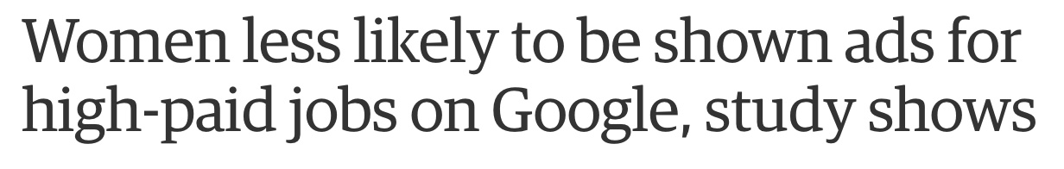
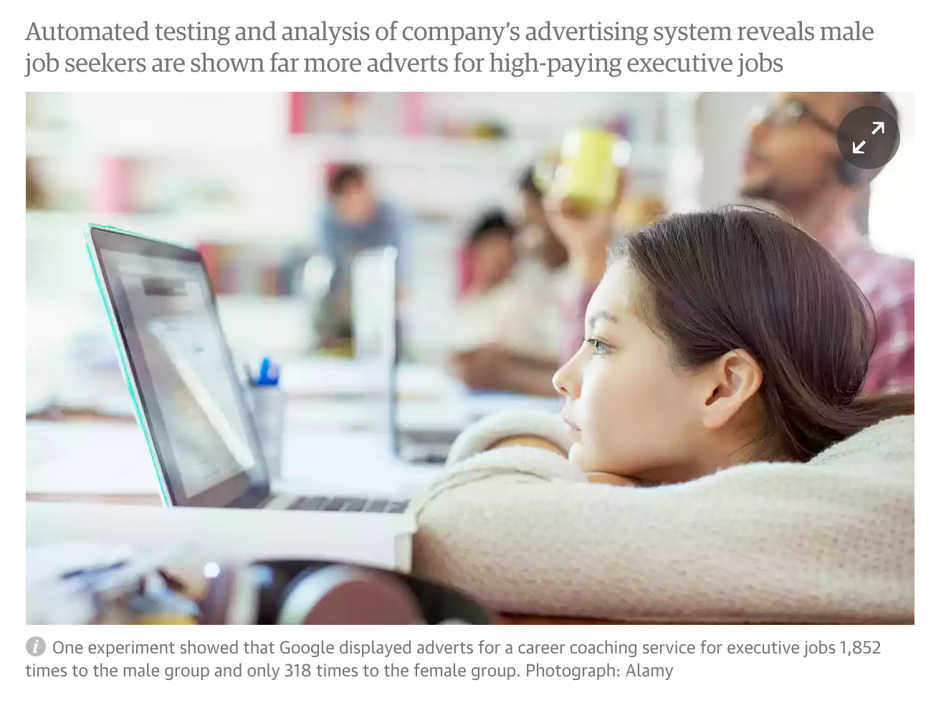
Online job ads
The AdFisher tool simulated job seekers that did not differ in browsing behavior, preferences or demographic characteristics, except in gender.
One experiment showed that Google displayed ads for a career coaching service for “$200k+” executive jobs 1,852 times to the male group and only 318 times to the female group. Another experiment, in July 2014, showed a similar trend but was not statistically significant.
https://www.theguardian.com/technology/2015/jul/08/women-less-likely-ads-high-paid-jobs-google-study

Slide 7
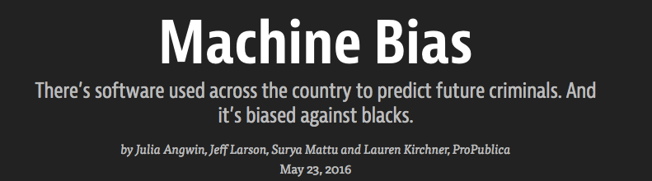

Racial bias in criminal sentencing
A commercial tool COMPAS automatically predicts some categories of future crime to assist in bail and sentencing decisions. It is used in courts in the US.
The tool correctly predicts recidivism 61% of the time.
Blacks are almost twice as likely as whites to be labeled a higher risk but not actually re-offend.
The tool makes the opposite mistake among whites: They are much more likely than blacks to be labeled lower risk but go on to commit other crimes.
https://www.propublica.org/article/machine-bias-risk-assessments-in-criminal-sentencing
https://www.propublica.org/article/machine-bias-risk-assessments-in-criminal-sentencing

Slide 8
Is data science impartial?
Data science is algorithmic, therefore it cannot be biased! And yet…
All traditional evils of discrimination, and many new ones, exhibit themselves in the data science eco system
Bias that is inherent in the data or in the process, and that is often due to systemic discrimination, is propelled and amplified
Transparency helps prevent discrimination, enable public debate, establish trust
Technology alone won’t do: also need policy, user involvement and education

Slide 9




Data, responsibly
Because of its power, data science must be used responsibly
fairness
transparency
data protection
diversity

Slide 10
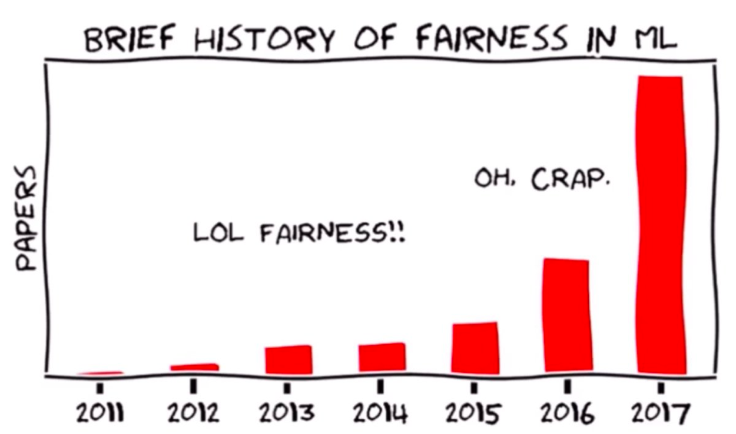
Fairness in ML
by Moritz Hardt

Slide 11
Fairness: a lack of “bias”
What are the tasks we are interested in?
predictive analytics and inferential interpretations
What do we mean by bias?
statistical bias: a model is biased if it doesn’t summarize the data correctly
societal bias: a dataset or a model is biased if it does not represent the world “correctly”, e.g., data is not representative, there is measurement error, or the world is “incorrect”
Depends on your perspective: the world as it is or as it should be?

Slide 12
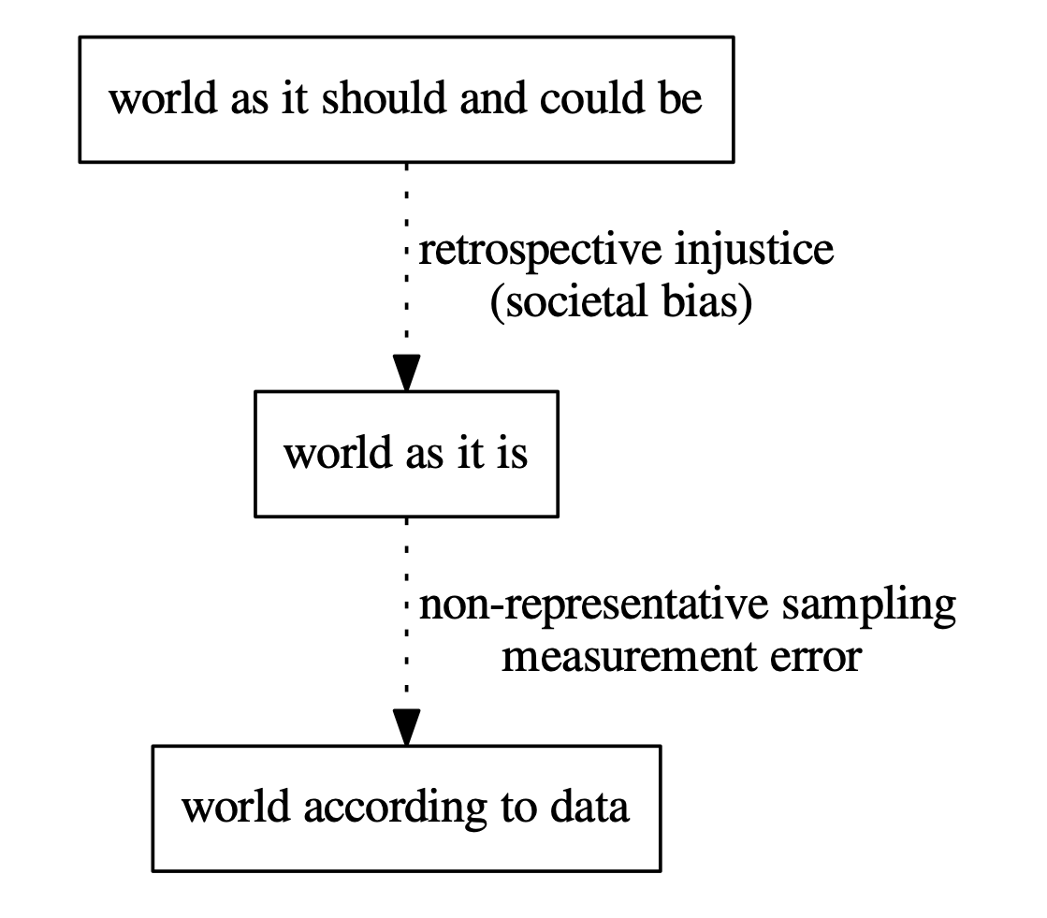
“Biased data”
from “Prediction-Based Decisions and Fairness” by Mitchell, Potash and Barocas, 2018
when data is about people, bias can lead to discrimination

Slide 13
The evils of discrimination
Disparate treatment is the illegal practice of treating an entity, such as a creditor or employee, differently based on a protected characteristic such as race, gender, age, religion, sexual orientation, or national origin.
Disparate impact is the result of systematic disparate treatment, where disproportionate adverse impact is observed on members of a protected class.
In the US, disparate impact measured by comparing the rate of positive outcomes for the protected class divided by rate of positive outcomes for the population as a whole.
If that ratio is less than 80%, it is considered discriminatory

Slide 14

Vendors and outcomes
Consider a vendor assigning positive or negative outcomes to individuals.
Positive Outcomes | Negative Outcomes
offered employment | denied employment
accepted to school | rejected from school
offered a loan | denied a loan
offered a discount | not offered a discount

Slide 15
Assigning outcomes to populations
Fairness is concerned with how outcomes are assigned to a population
positive outcomes
40% of the population
◦
◦
◦
◦
◦
◦
⊕
⊕
⊖
◦
◦
◦
⊖
◦
⊖
◦
◦
⊖
◦
◦
⊕
◦
◦
⊕
◦
◦
⊖
◦
◦
⊖
population
assignments
individual with
negative outcome
individual with
positive outcome

Slide 16
Sub-populations may be treated differently
Sub-population: those with red hair
(under the same assignment of outcomes)
positive
outcomes
40% of the whole population
hair color | red
 | not red
20%
of red
haired
disparate
impact
on red-haired
people
⊕
⊖
⊖
⊖
⊖
}
⊖
⊕
60%
of not red
haired
statistical
parity
fails
⊕
⊕
⊖

Slide 17

Statistical parity
Statistical parity (a popular group fairness measure):
demographics of the individuals receiving any outcome are the same as demographics of the underlying population
positive
outcomes
40% of the whole population
hair color | red
 | not red
40%
of red
haired
⊕
⊖
⊖
⊖
⊕
⊖
⊖
40%
of not red
haired
⊕
⊕
⊖
outcomes swapped

Slide 18
Redundant encoding
Now consider the assignments under both
hair color (protected) and hair length (innocuous)
 |  | hair length
 |  | long | not long
hair color | red
 | not red
positive
outcomes
⊖
⊖
20%
of red
haired
⊕
⊖
⊖
60%
of not red
haired
⊕
⊕
⊖
⊕
⊖
Deniability
The vendor has adversely impacted red-haired people, but claims that outcomes are assigned according to hair length.

Slide 19
Blinding is not an excuse
Removing hair color from the vendor’s assignment process does not prevent discrimination! This is upheld in the legal system.
 |  | hair length
 |  | long | not long
hair color | red
 | not red
positive
outcomes
⊖
⊖
20%
of red
haired
⊕
⊖
⊖
60%
of not red
haired
⊕
⊕
⊖
⊕
⊖
Assessing disparate impact
Discrimination is assessed by the effect on the protected sub-population, not by the input or by the process that lead to the effect.

Slide 20
Redundant encoding
Let’s replace hair color with race (protected), and hair length with zip code (innocuous)
 |  | zip code
 |  | 10025 | 10027
race | black
 | white
positive
outcomes
⊖
⊖
20%
of black
⊕
⊖
⊖
60%
of white
⊕
⊕
⊖
⊕
⊖

Slide 21
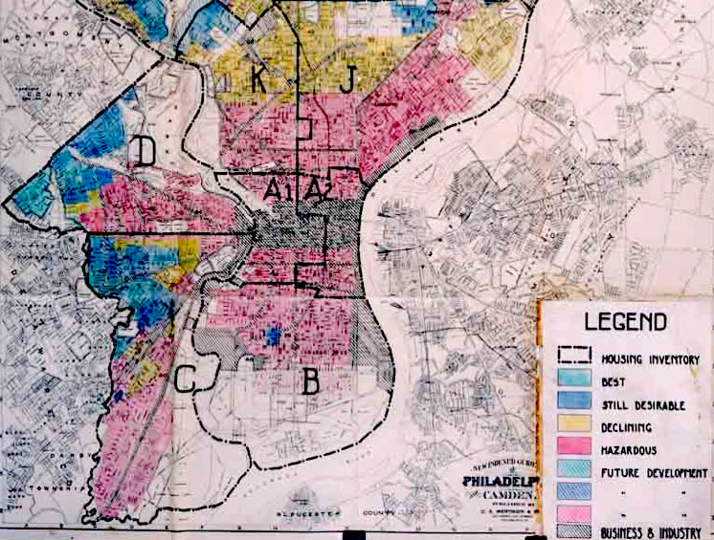
Redlining
Redlining is the practice of arbitrarily denying or limiting financial services to specific neighborhoods, generally because its residents are people of color or are poor.
Philadelphia, 1936
Households and businesses in the red zones could not get mortgages or business loans.
wikipedia

Slide 22

Imposing statistical parity
May be contrary to the goals of the vendor
positive outcome: offered a loan
 |  | credit score
 |  | good | bad
 | black
 | white
positive
outcomes
⊖
⊖
40%
of black
⊕
⊕
⊖
race
40%
of white
⊕
⊖
⊖
⊕
⊖
Impossible to predict loan payback accurately.
Use past information, which may itself be biased.

Slide 23

Is statistical parity sufficient?
Statistical parity (a popular group fairness measure)
demographics of the individuals receiving any outcome are the same as demographics of the underlying population
 |  | credit score
 |  | good | bad
 | black
 | white
positive
outcomes
⊖
⊖
40%
of black
⊕
⊕
⊖
race
40%
of white
⊕
⊖
⊖
⊕
⊖
Individual fairness
any two individuals who are similar w.r.t. a particular task should receive similar outcomes

Slide 24
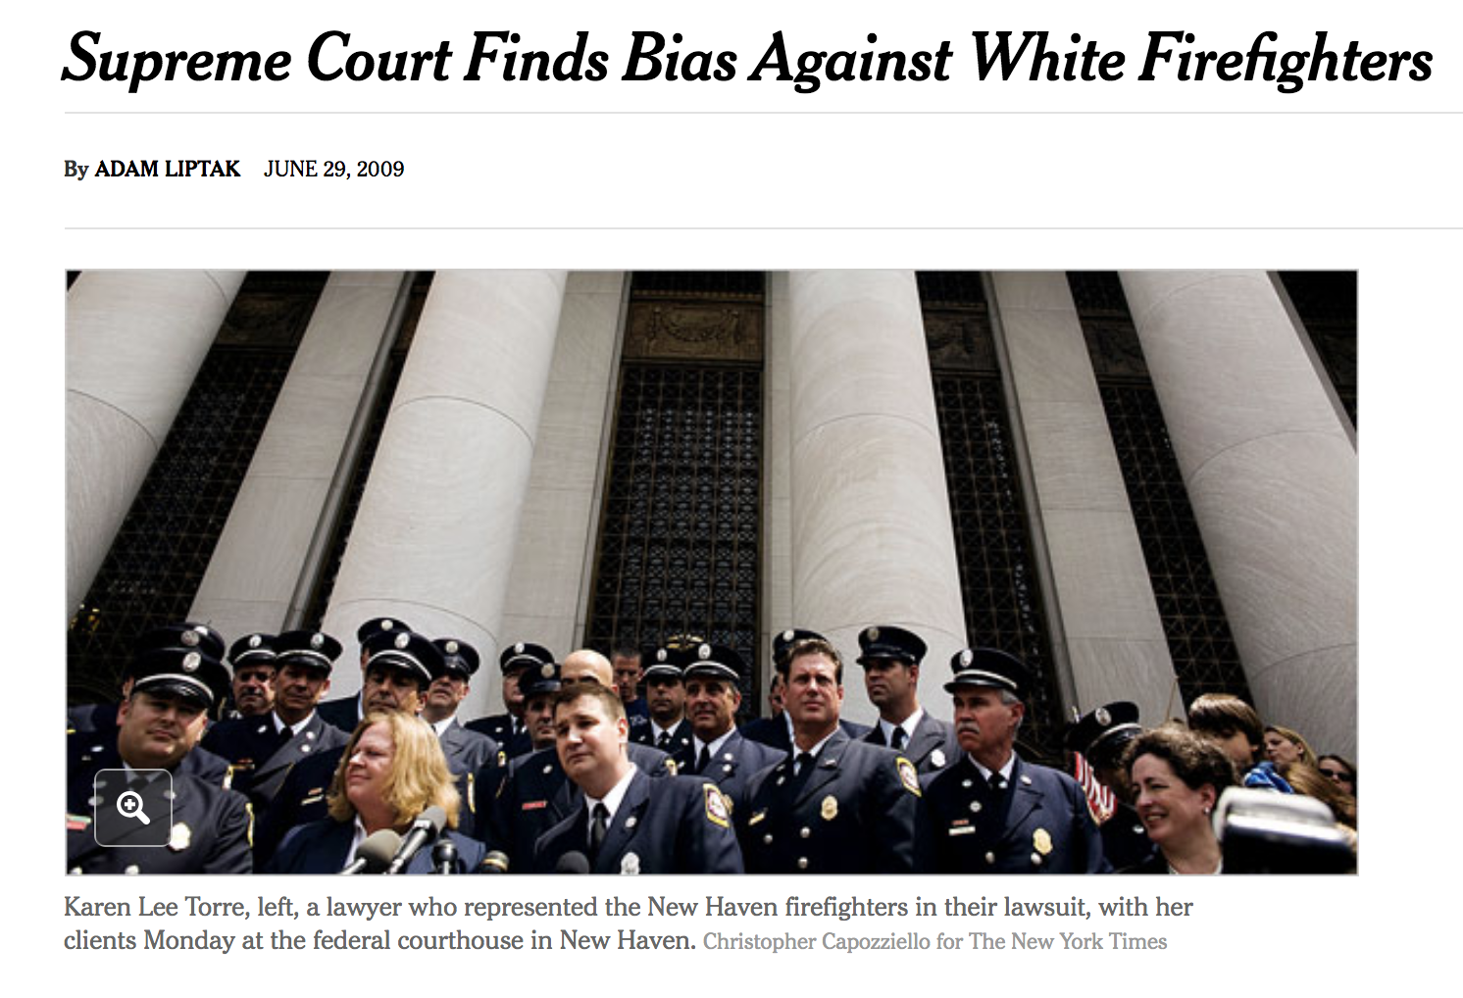

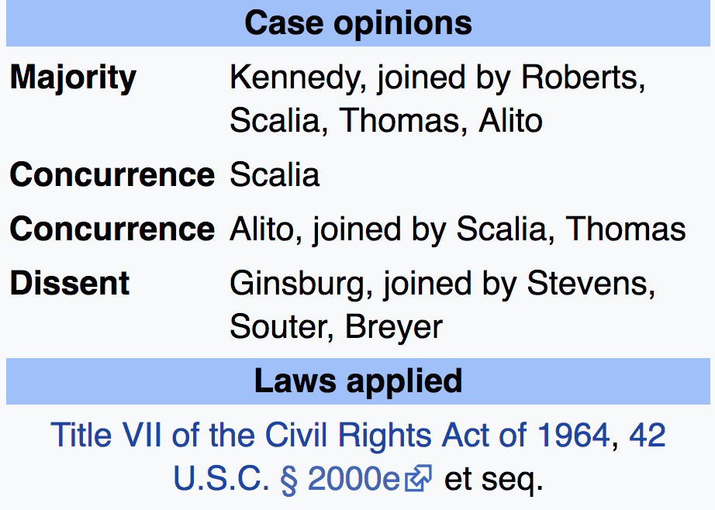
Ricci v. DeStefano (2009)

Slide 25
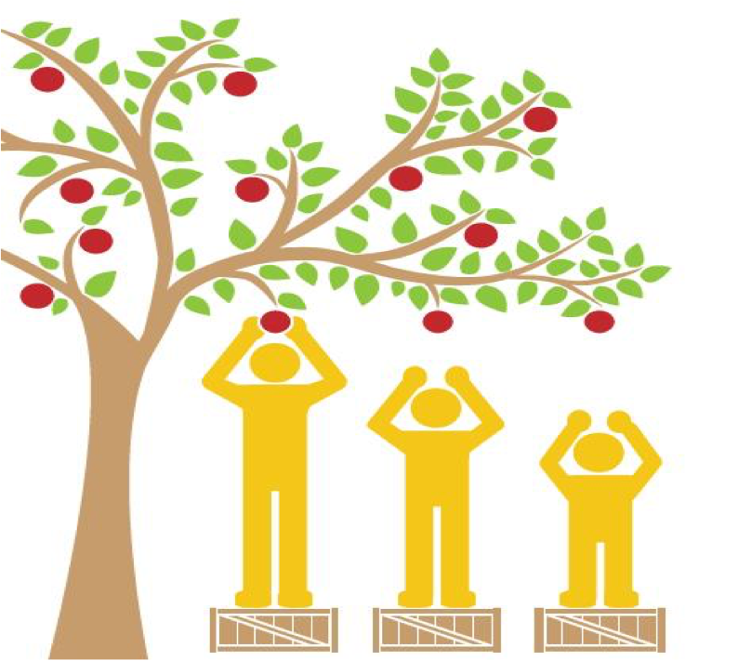

Two notions of fairness
individual fairness
group fairness
equality
equity
two intrinsically different world views

Slide 26
On the (im)possibility of fairness
2 intrinsically different worlds views
What you see is what you get (WYSIWYG) - individual fairness
We are all equal (WAE) - group fairness
Goal: tease out the difference between beliefs about fairness and mechanisms that logically follow from those beliefs.
Construct Space (CS) | Observed Space (OS) | Decision Space (DS)
intelligence | SAT score | performance in college
grit | high-school GPA
propensity to commit crime | family history | recidivism
risk-averseness | age

Slide 27
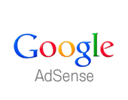
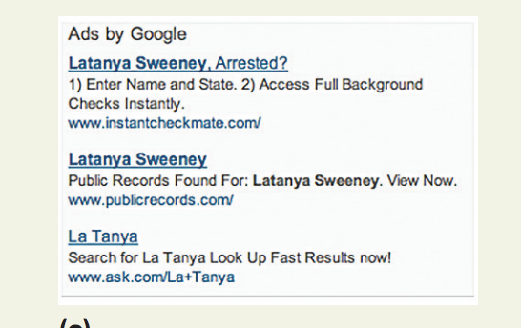
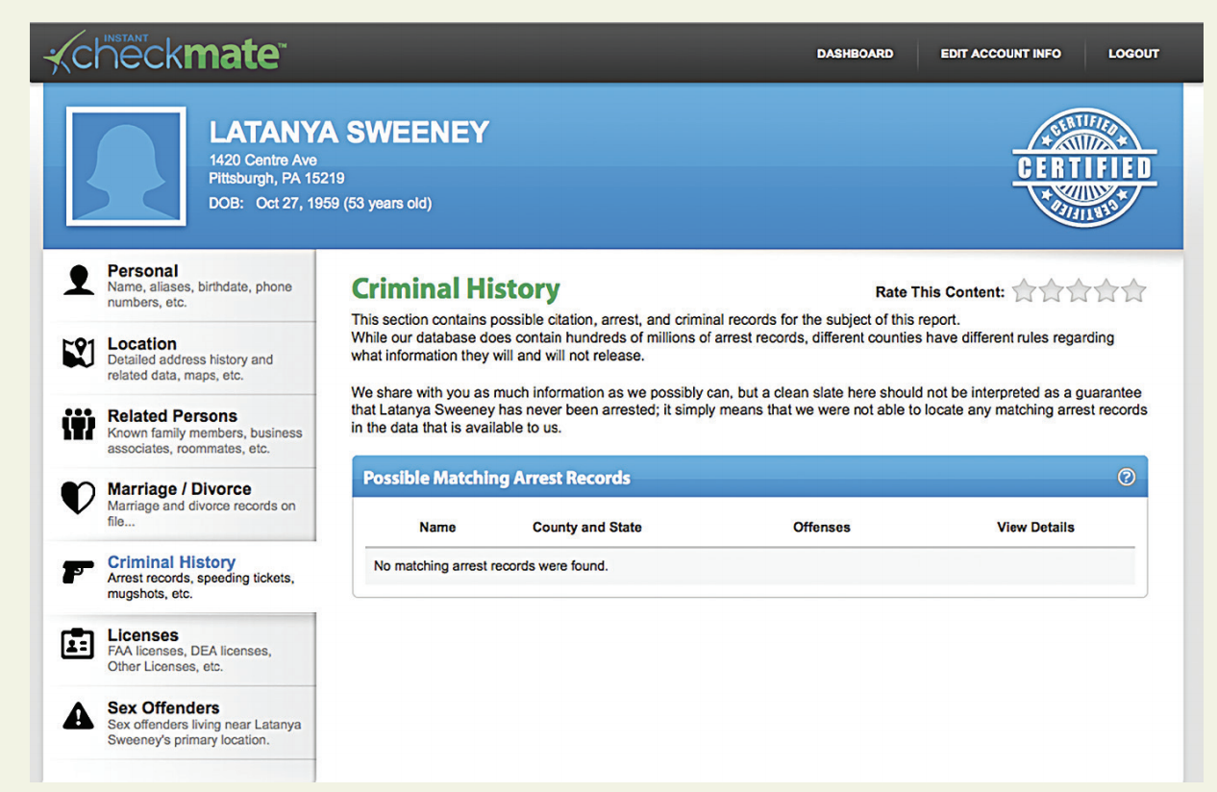
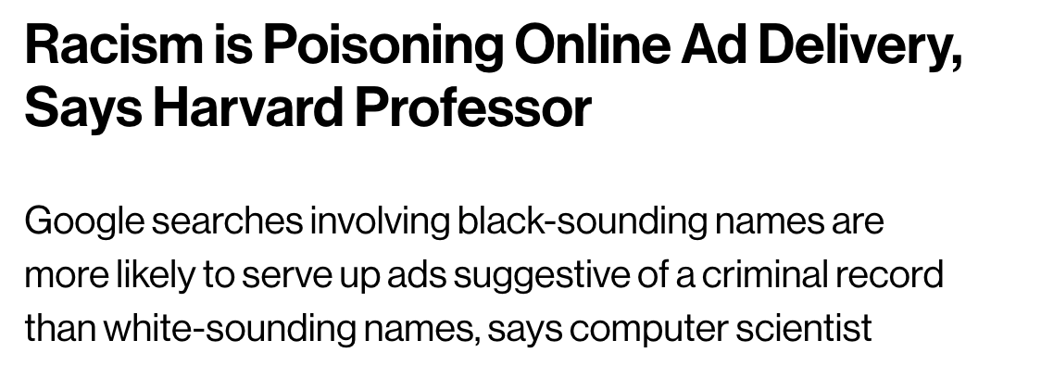
Racially identifying names
[Latanya Sweeney; CACM 2013]
racially identifying names trigger ads suggestive of a criminal record
https://www.technologyreview.com/s/510646/racism-is-poisoning-online-ad-delivery-says-harvard-professor/

Slide 28
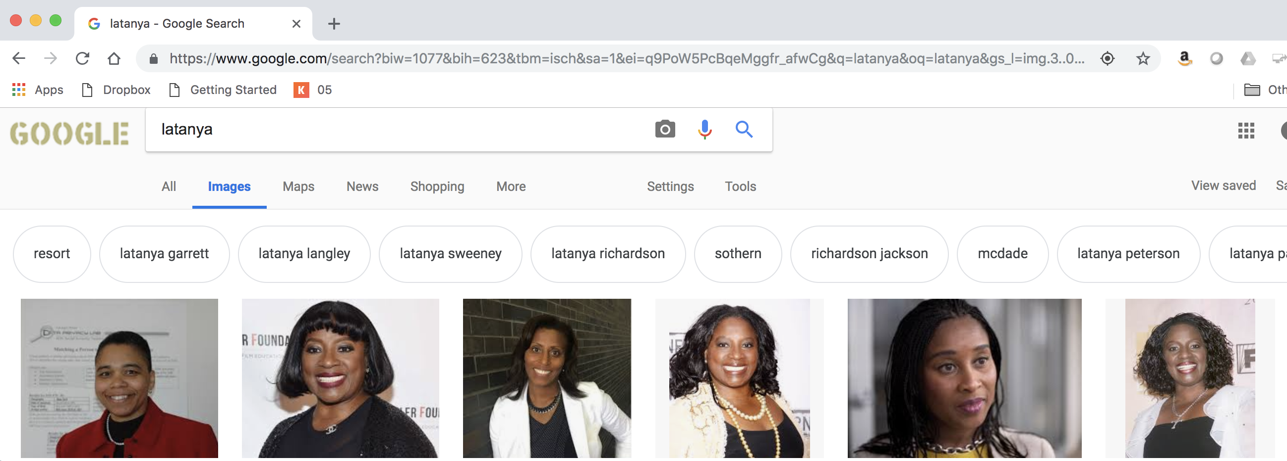
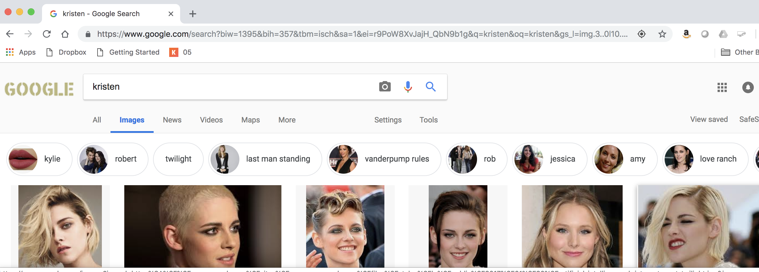
Observations
[Latanya Sweeney; CACM 2013]
Ads suggestive of a criminal record, linking to Instant Checkmate, appear on google.com and reuters.com in response to searches for “Latanya Sweeney”, “Latanya Farrell”and “Latanya Lockett”*
No Instant Checkmate ads when searching for “Kristen Haring”, “Kristen Sparrow”* and “Kristen Lindquist”*
* next to a name associated with an actual arrest record
latanya
kristen

Slide 29
Why is this happening?
[Latanya Sweeney; CACM 2013]
Possible explanations (from Latanya Sweeney):
Does Instant Checkmate serve ads specifically for black-identifying names?
Is Google’s Adsense explicitly biased in this way?
Does Google’s Adsense learn racial bias based on click-through rates?
How do we know which explanation is right?
We need transparency!

Slide 30

Codes of ethics

Slide 31
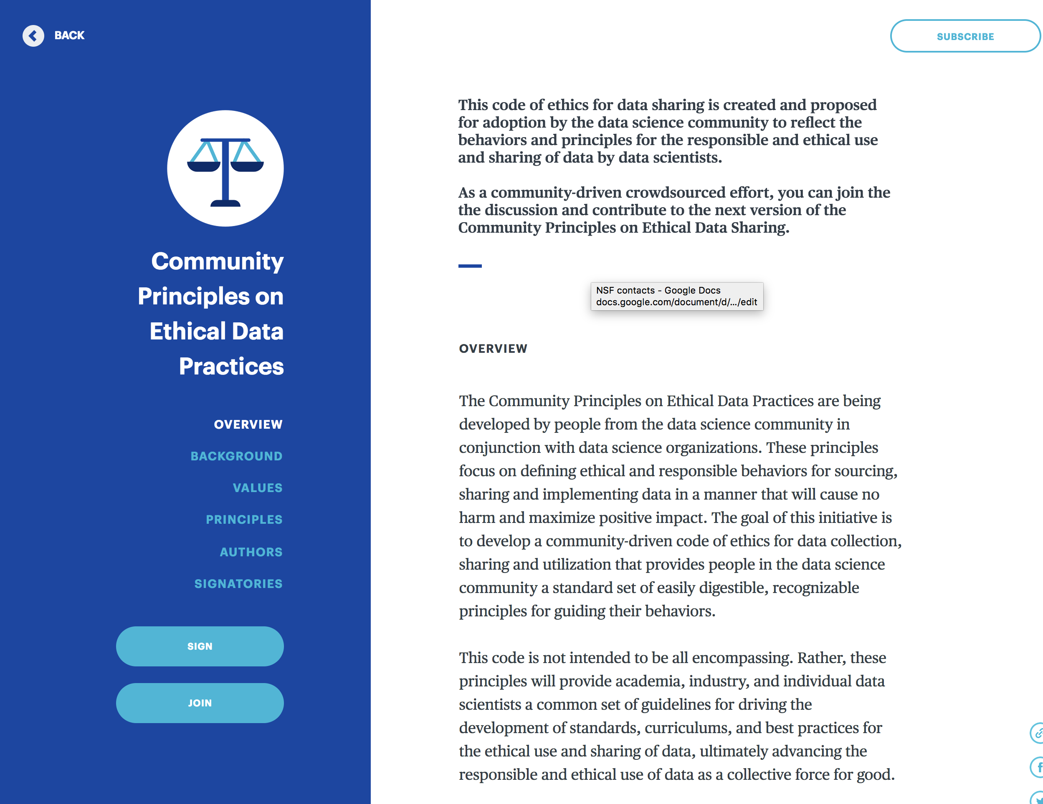
Codes of ethics

Slide 32
Case Study: Bias in the COMPAS algorithm

Slide 33
Racial bias in criminal sentencing
ProPublica is “an independent, non-profit newsroom that produces investigative journalism in the public interest.”
ProPublica investigated COMPAS, a commercial tool that automatically predicts some categories of future crime to assist in bail and sentencing decisions. It is used in courts in the US.
https://www.propublica.org/article/machine-bias-risk-assessments-in-criminal-sentencing

Slide 34
Automated risk assessment
Goal: predict the likelihood of some category of future crime
Used by judges to assist in (1) assigning bail amounts and (2) sentencing
Intended use of the algorithm was different - to provide supportive interventions!

Slide 35
Algorithm
Input: attributes of individuals, based on a 137-question questionnaire answered by defendants. Questions are from the following categories:
current charges, criminal history, non-compliance history, family criminality, peers, substance abuse, residence/stability, social environment, education, vocation, leisure/recreation, social isolation, criminal personality, anger, criminal attitudes
race is not a feature!

Slide 36
Example questions
“Was one of your parents ever sent to jail or prison?”
“How many of your friends/acquaintances are taking drugs illegally?”
“How often did you get into fights while at school?”
Agree or disagree with statements such as:
“A hungry person has a right to steal.” and
“If people make me angry or lose my temper, I can be dangerous.”

Slide 37
Training Data
The original training data were based on a subset of Michigan and New York inmates and parolees. Even though it was trained on mostly male observations, the score is said to be “gender-neutral.”
The algorithm/score was revised and tuned to a new training group:
“normative data were sampled from over 30,000 COMPAS Core assessments conducted between January 2004 and November 2005 at prison, parole, jail and probation sites across the United States.” This is the normative group that the risk assessments are based on today.
Output: risk score [1,10]
risk for general recidivism
risk for violent recidivism

Slide 38
Output Score
Output: risk score [1,10]
risk for general recidivism
risk for violent recidivism
These scores are often put into 2 or 3 categories of low-risk, medium-risk, and high-risk of recidivism.
The predicted risk groups are then assessed via the standard false positive and false negative rates, and the AUC score is used to tune the output and compare to other predictive models.

Slide 39
Risk Assessment Results (in Broward County, Fla.)
Black Defendants’ Risk Scores White Defendants’ Risk Scores

Slide 40
Recidivism Results (in Broward County, Fla.)
Prediction Fails Differently for Black Defendants
 | WHITE | AFRICAN AMERICAN
Labeled Higher Risk, But Didn’t Re-Offend | 23.5% | 44.9%
Labeled Lower Risk, Yet Did Re-Offend | 47.7% | 28.0%

Slide 41
Discussion Questions:
Is COMPAS a fair algorithm? Think about this from both the individual and group perspective.
How can the COMPAS algorithm predict different rates of recidivism for racial groups even though race was not an input into the prediction model? (How) can this be corrected?
What factors could be causing the observed differences

Slide 42
Course Wrap-Up

Slide 43
Modules
The semester has been organized into 4 major ‘modules’:
Module 0: Intro to Data and Data Science (and Python)
Module 1: Regression
Module 2: Classification
Module 3: Ensemble Methods
We have learned various approaches to perform both predictions and inferences within each of these frameworks.

Slide 44
Module 1: Regression Methods
When is it appropriate to perform a regression method? What regression models have we learned?
Linear Regression (simple, multiple, polynomial, interactions, model selection, Ridge & Lasso, etc...)
k-NN
Regression Trees
What is the main difference between these types of models?

Slide 45
Module 2: Classification Methods
When is it appropriate to perform a classification method? What classification models have we learned?
Logistic Regression: same details as linear regression apply
k-NN
Classification Trees
What is the main difference between these types of models (advantages and disadvantages)? When should you use each method?

Slide 46
Module 3: Ensemble Methods
What does it mean for a model to be an ensemble method?
Bagging Trees
Random Forests
Boosting Models
Stacking Models
Neural Networks
What approach does each model take to improve prediction accuracy?

Slide 47
Choosing between Models
How can we choose between our various methods/models to answer a question at hand? What approaches/measures can we use to make this determination?
In-sample: AIC, BIC (barely mentioned)
Out-of-sample: Cross-Validation
What measure(s) should we use when we perform cross-validation?

Slide 48
Dealing with Data Issues
What issues have arisen when dealing with real data? How have we handled them?
Categorical Predictors: might make sense to one-hot encode
Missing Data: might make sense to impute
High Dimensionality: might make sense to use a data reduction technique.
Too many observations: do preliminary analysis on a subset
How are predictions affected? How are inferences affected?

Slide 49
Dealing with High Dimensionality
What does ‘high dimensionality’ mean? What issues arise when this happens? How can we handle it?
Model Selection: subset variable selection
Regularization: LASSO and Ridge like approaches (penalize the loss function)
PCA: create new predictor variables that encapsulate the ‘essence’ of all your predictor data with a minimal number of variables.
How can we compare methods to determine which approach is best?

Slide 50
Other things we’ve learned
Scraping, Data Gathering, Data Wrangling
EDA: Visualization and Summary Statistics
t-tests and p-values: probabilistic/ approaches to perform inferences
Bootstrapping: empirical approach to perform inferences
Misclassification Rates, Types of Errors, Confusion Matrices/Tables, and ROC Curves
Bias-Variance Trade-off
Train vs. Test vs. Validation
Standardization vs. Normalization. When should we do it?
Data Ethics
Anything lingering questions or thoughts?

Slide 51
Other things we haven’t discussed
There are lots of topics we have not covered in one semester…some are covered in 109B in the Spring:
AB testing and Causal Inference
Unsupervised Classification/Clustering
Smoothers
Bayesian Data Analysis
Reinforcement Learning
Other versions of Neural Networks (and ‘Deep Learning’)
Interactive Visualizations
Database Management (SQL, etc.)
Cloud Computing and Scaling (AWS)
And much, much more…

Slide 52
Courses Related to Data Science
CS 109B: Advanced Topics in Data Science
CS 171: Visualizations
CS 181/281: Machine Learning
CS 182: Artificial Intelligence (AI)
CS 205: Distributive Computing
Stat 110/210: Probability Theory
Stat 111/211: Statistical Inference
Stat 139: Linear Models
Stat 149: Generalized Linear Models
Stat 195: Intro to Statistical Machine Learning
This list is not exhaustive!

Slide 53
What?
The Data Science Process
Ask an interesting question
Get the Data
Explore the Data
Model the Data
Communicate/Visualize the Results

Slide 54

Thanks for all your hard work!
It’s been a long semester for everyone involved. Thank you for your patience, your hard work, and your commitment to data science!
It’s sad to see you go...

